Slide 1
Continuing Education: Finite Element Methods
2D Truss Elements
Direct Stiffness Method
3D Truss Elements

Slide 2
2D Truss Element Requires Transformation Equations
Y
x’
u’_{j}
v’_{j}
φ_{y}
v_{j}
y_{j}
y’
j
u’_{i}
φ_{x}
u_{j}
v_{i}
y_{i}
i
v’_{i}
u_{i}
X
x_{i}
x_{j}
Notes:
x,y – Global Coordinates
x’,y’ – Local Coordinates

Slide 3
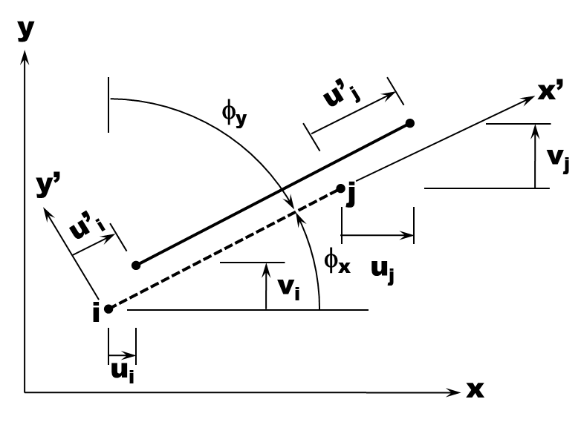
u Displacement Transformed from Global to Local System
v⋅sinφ_{x}
=v⋅cosφ_{y}
u’
φ_{x}
u⋅cosφ_{x}
v
φ_{x}
u

Slide 4
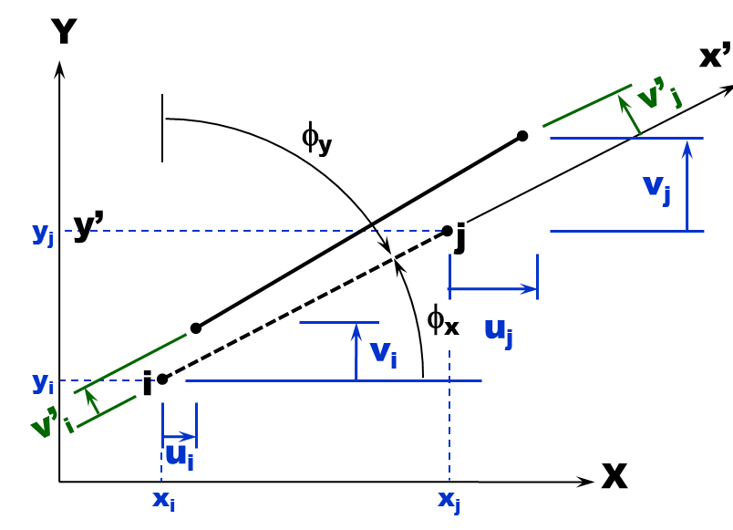
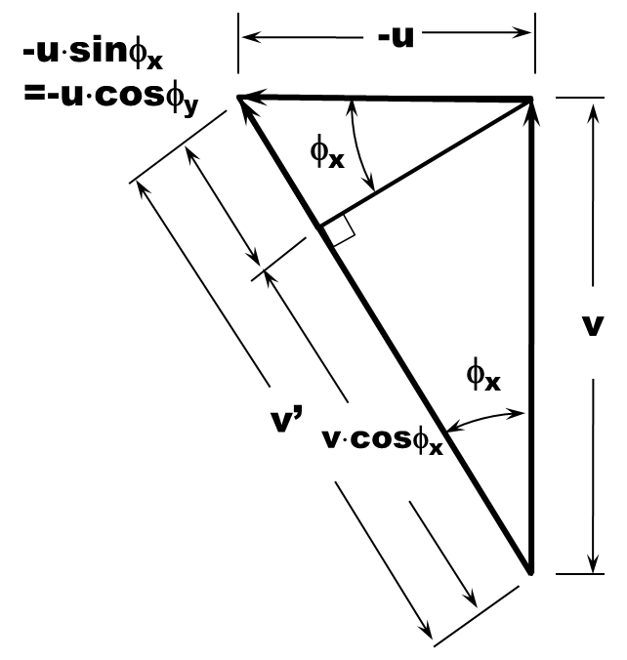
v Displacement Transformed from Global to Local System

Slide 5
Transformations from Global to Local System in Matrix Form

Slide 6
The System Of Equations is Formed In Global Coordinates

Slide 7
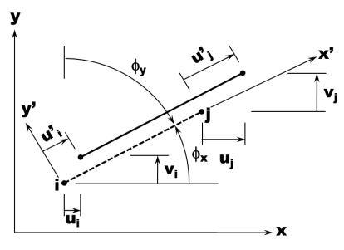
Forming The System Matrix More Complex Than 1D Case
34
35
Nodes do not follow each other in a serial manner
Two DOF at each node
Simplification to help organize the problem
For a given Element, always define
The lower element as the i node
The higher element as the j node
After the element equations are formulated with respect to the Element DOF, then expand with respect to the System DOF

Slide 8
Example
2 m
2 kN
Determine the nodal deflections, nodal forces, and stress in each of the elements of the truss. Ignore buckling. Each member has a cross sectional area of 80 mm². The members have a modulus of 200 Gpa.
2 m
3 kN

Slide 9
Transformations for the 3D Truss Element
y
x’
θ_{y}
L_{e}
θ_{x}
y’
x
z’
θ_{z}
z
36

Slide 10
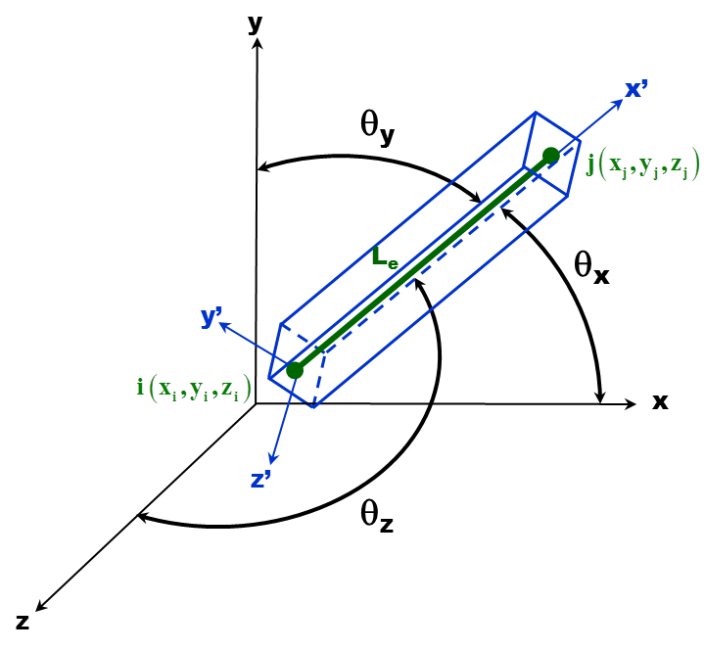
The Local Stiffness Matrix Can Now Be Transformed

